Slide 1

Introduction
Methods
Experimental Result
Conclusion
Harbin Institute of Technology
Active appearance models
李峥
2190400609
2022.4.12

Slide 2
background
Model Implementation
Results
Introduction
Methods
Experimental Result
Conclusion
Harbin Institute of Technology
Introduction
History:
1.Snake (Active Contour Models) –1989
2.ASM (Active Shape Models) –1995
3. Combined Appearance Models
4.AAM (Active Appearance Models)[1] --1998

Slide 3
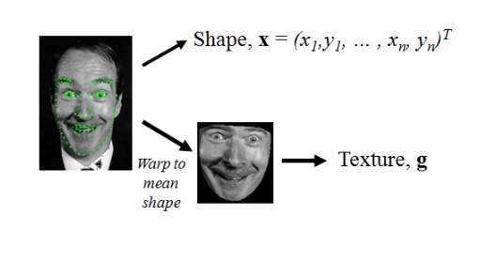
background
Model Implementation
Results
Introduction
Methods
Experimental Result
Conclusion
Harbin Institute of Technology
CAM

Slide 4
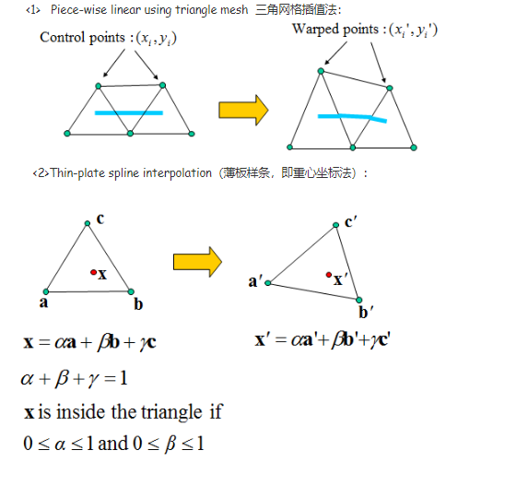

background
Model Implementation
Results
Introduction
Methods
Experimental Result
Conclusion
Harbin Institute of Technology
CAM
变形方法 Delaunay三角划分

Slide 5

background
Model Implementation
Results
Introduction
Methods
Experimental Result
Conclusion
Harbin Institute of Technology
CAM
shape model：
texture model：
c: 模型参数
：the modes of variation derived from the training set.
从训练集中获得的矩阵,表示每一个样本经过处理后的特征

Slide 6
background
Model Implementation
Results
Introduction
Methods
Experimental Result
Conclusion
Harbin Institute of Technology
Introduction
History:
1.Snake (Active Contour Models) –1989---迭代、函数最小化
2.ASM (Active Shape Models) –1995---形状模型
3. Combined Appearance Models----图像变形
4.AAM (Active Appearance Models)[1] --1998

Slide 7
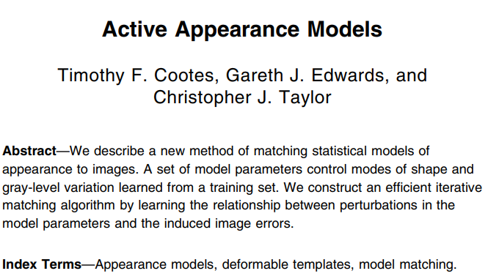
background
Model Implementation
Results
Introduction
Methods
Experimental Result
Conclusion
Harbin Institute of Technology
Introduction
解决问题：人脸关键点检测->人脸识别
核心：特征点提取\图像分割
关键词：
形状模型+灰度变化模型

Slide 8
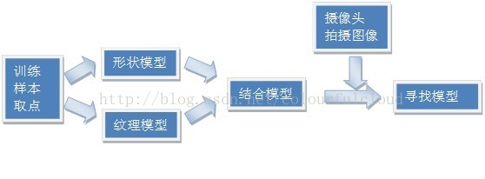
background
Model Implementation
Results
Introduction
Features
AdaBoost
Cascade
Introduction
Methods
Experimental Result
Conclusion
Harbin Institute of Technology
Methods
AAM(Active Appearance Model)主动外观模型
主要分为两个阶段：
（1）模型建立：对训练样本分别建立形状模型(Shape Model)和纹理模型(Texture Model)，然后将两个模型进行结合，形成AAM模型。
（2）模型匹配：在视频序列中将已建立好的AAM模型在当前帧图像中寻找最匹配的目标的过程。

Slide 9
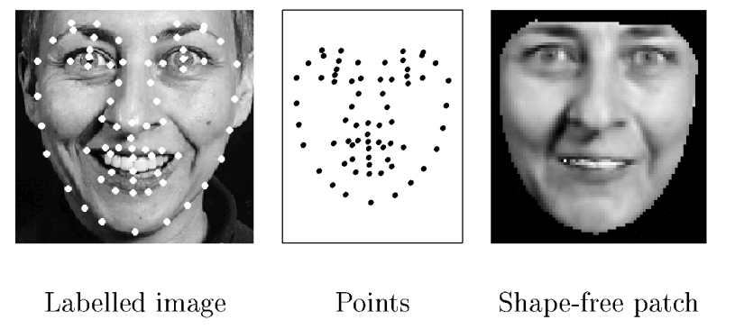
background
Model Implementation
Results
Introduction
Features
AdaBoost
Cascade
Introduction
Methods
Experimental Result
Conclusion
Harbin Institute of Technology
Methods
1.样本选取与标定
a.样本采集（400）
b.样本取点（68）
c.样本数据处理（向量）

Slide 10
background
Model Implementation
Results
Introduction
Features
AdaBoost
Cascade
Introduction
Methods
Experimental Result
Conclusion
Harbin Institute of Technology
Methods
2.形状模型（Shape Model）
a.Procrustes变换
b.PCA降维
c.样本数据处理（向量）
3.纹理模型（Texture Model）
a.Delaunay三角划分
b.三角映射
c. PCA降维

Slide 11
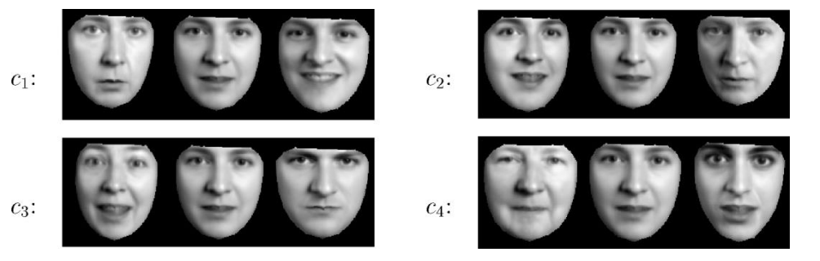
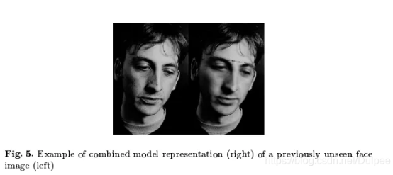

background
Model Implementation
Results
Introduction
Methods
Experimental Result
Conclusion
Harbin Institute of Technology
Methods
4.组合模型（Combine Model）
shape model：
texture model：
下一步使用PCA来判断Qs与Qg之间是否存在某种关联性，从而生成级联向量,得到：

Slide 12
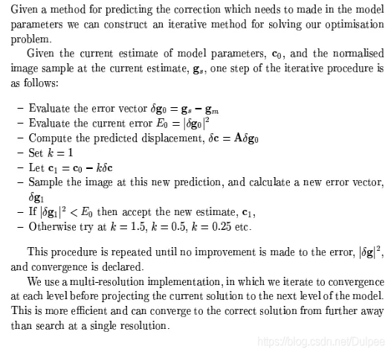



background
Model Implementation
Results
Introduction
Features
AdaBoost
Cascade
Introduction
Methods
Experimental Result
Conclusion
Harbin Institute of Technology
Methods
5.搜索模型(Search Model)
1.初始化
2.最小化差值：
3.主要解决问题:(1)I与模型参数中的误差
(2)C和最小化Δ的迭代算法中的关系
预测参数I变化:其中C=A*I其中线性回归变换矩阵A可以在训练阶段通过人为干扰的方法获得。
4.尝试新模型参数：
5.重新计算误差函数I
6.比较,如果Δ<Δ’,则接受Ct’作为新的参数如上图，否则转第4步，尝试k=1.5;0.5;0.25等
7. t=t+1，如果 ，或超过预设迭代次数，则退出，否则返回第二步。

Slide 13
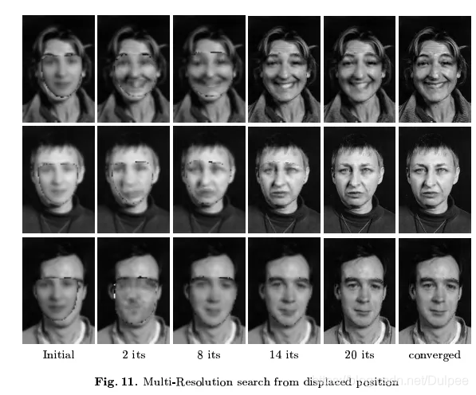
background
Model Implementation
Results
Introduction
Features
AdaBoost
Cascade
Introduction
Methods
Experimental Result
Conclusion
Harbin Institute of Technology
Results

Slide 14
background
Model Implementation
Results
Introduction
Features
AdaBoost
Cascade
Introduction
Methods
Experimental Result
Conclusion
Harbin Institute of Technology
Conclusion
1.方法过程：模型训练+模型匹配
2.核心点：不仅采用形状约束，而且又加入整个脸部区域的纹理特征
3.应用：人脸识别
4.存在问题：局部最优

Slide 15
background
Model Implementation
Results
Introduction
Features
AdaBoost
Cascade
Introduction
Methods
Experimental Result
Conclusion
Harbin Institute of Technology
End
Thank You!

